Slide 1
Graphs - 4
CSE 2213 – Discrete Mathematics
Course Instructor: Al-Sakib Khan Pathan, PhD, SMIEEE [Professor, CSE, UIU]
Based on the slides of Minhajul Bashir

Slide 2
Graph connectivity

Slide 3
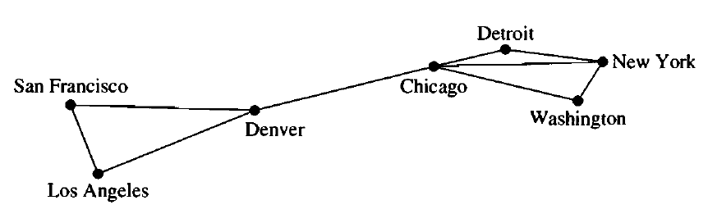
Path and circuit
There is a path from San Francisco to New York
The path length is 3

Slide 4
Path and circuit
There is a circuit from Detroit to Detroit via New York, Washington and Chicago
The circuit length is 4

Slide 5
Path and circuit
Is San Francisco (SF)-Denver-Chicago-Denver-Los Angeles (LA) a path from SF to LA?
Is Denver-Chicago-Denver a circuit from Denver to Chicago?

Slide 6
Simple path and simple circuit
A path with no repeated edge is a simple path
A circuit with no repeated edge is a simple circuit

Slide 7
Connectedness in undirected graphs

Slide 8
Connected graph
We can reach any vertex from any other vertex in this graph
This graph is a connected graph

Slide 9
Connected graph
We cannot reach LA from NY
So the graph is not connected

Slide 10
Connected components
We can communicate between LA, SF and Denver
We can communicate between Detroit, New York, Chicago and Washington
These are connected components

Slide 11
Connectedness in directed graphs

Slide 12
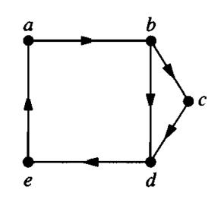
Strongly connected graph
We can reach any vertex from any other vertex in this graph
This graph is a strongly connected graph

Slide 13
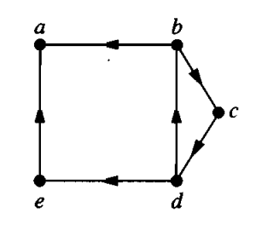

Weakly Connected graph
We cannot reach from $a$ to $b$
So the graph is not strongly connected
But it is weakly connected
Because $a$ and $b$ are connected by an edge

Slide 14
Weakly Connected graph
We say a directed graph is weakly connected if its underlying undirected graph is connected
Imagine rickshaws going to the wrong side :P

Slide 15

Strongly connected components
This graph has three strongly connected components, consisting of the vertex a; the vertex e; and the subgraph consisting of the vertices b, c, and d and edges (b, c), (c, d), and (d, b).
The subgraphs of a directed graph G that are strongly connected but not contained in larger strongly connected subgraphs, that is, the maximal strongly connected subgraphs, are called the strongly connected components or strong components of G.
We can communicate between $b,c,d$
We cannot communicate from $a$ to anywhere
We can only communicate to $a$ from $e$
These are strongly connected components

Slide 16
Definition Again !! – Strongly Connected
A directed graph is strongly connected if there is a path from a to b and from b to a whenever a and b are vertices in the graph.

Slide 17
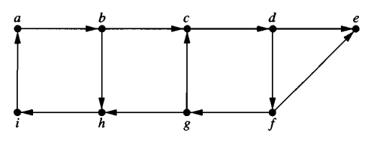
Exercise
Is the following graph strongly connected? If not, find out strongly connected components of this graph:

Slide 18
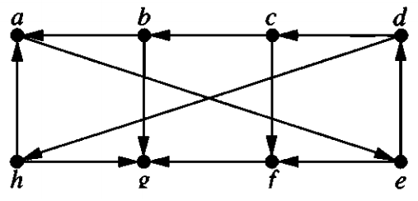
Exercise
Find out strongly connected components of this graph:

Slide 19
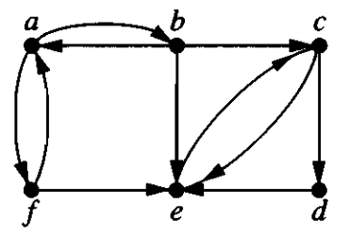
Exercise
Find out strongly connected components of this graph:

